Slide 1

SQL Server

Slide 2
Indexes

Slide 3
Index Outlines
What is an Index and Use of Indexes ?
When should indexes are required and when indexes are avoided ?
Types of Indexes in SQL Server
How to see the List of Indexes In Table / DB level ?
Enable / Disable Indexes
Rename / Drop Indexes
Unique and Filtered Indexes
Indexes with Included Columns
Indexes with Computed Columns

Slide 4

What is Index and use of Index ?
An Index in SQL Server is a data structure associated with tables and views that helps in faster retrieval of rows.
Data in a table is stored in rows in an unordered structure called Heap.
If you have to fetch data from a table, the query optimizer has to scan the entire table to retrieve the required row(s).
If a table has a large number of rows, then SQL Server will take a long time to retrieve the required rows. So, to speed up data retrieval, SQL Server has a special data structure called indexes.
An index is mostly created on one or more columns which are commonly used in the SELECT clause or WHERE clause.

Slide 5
When should indexes are required and when indexes are avoided ?
We can create an index in the following cases
When a column has a wide range of values
When the column does not have a large number of null values
When single or multiple columns used together in a where or join clause
We can avoid an index in the following cases
When a table is small
When the columns aren't used as a query condition
When the column is constantly updated

Slide 6
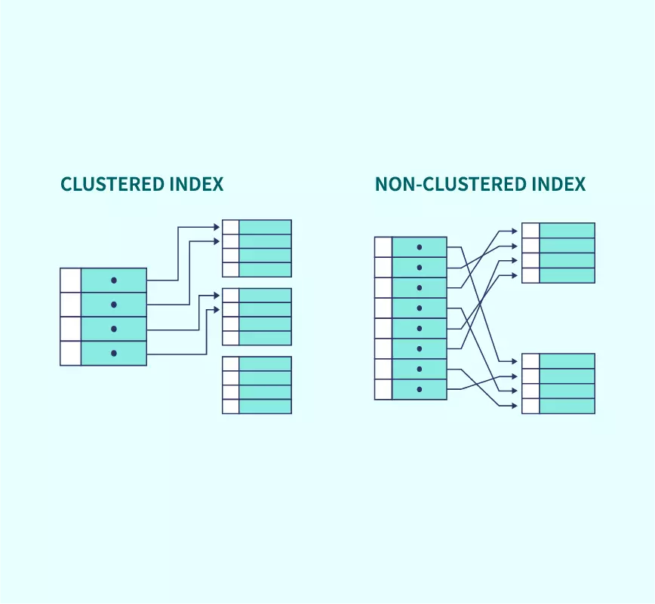
Types of Indexes
There are mainly two types of indexes in SQL Server
1. Clustered Indexes
2. Non-Clustered Indexes
Clustered Index
The clustered index defines the order in which the table data will be sorted and stored.
When you define a clustered index on a column, it will sort data based on that column values and store it.
Thus, it helps in faster retrieval of the data.
There can be only one clustered index on a table because the data rows can be stored in only one order.
When you create a Primary Key constraint on a table, a unique clustered index is automatically created on the table.

Slide 7
Syntax for Create Clustered Index
Create Clustered Index using SSMS and Table Designer
Non-Clustered Indexes
The non-clustered index does not sort the data rows physically.
It creates a separate key-value structure from the table data where the key contains the column values, and each value contains a pointer to the data row that contains the actual value.
It is similar to a textbook having an index at the back of the book with page numbers pointing to the actual information.
There can be non-clustered indexes on a single table is 999.
When you create a Unique constraint, a unique non-clustered index is created on the table.
CREATE CLUSTERED INDEX <index_name>
ON [schema.]<table_name>(column_name [asc|desc]);

Slide 8
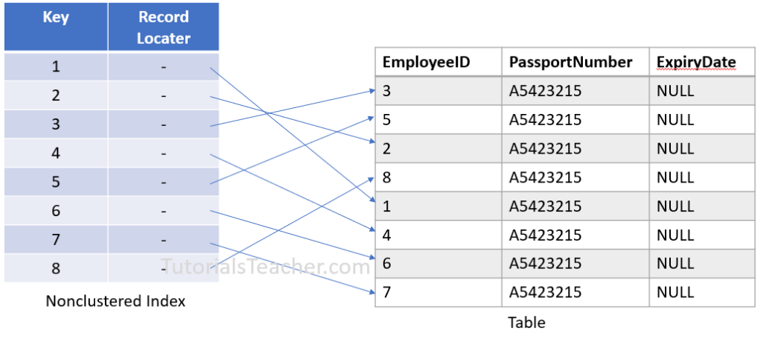
Syntax to create Non-Clustered Index:
Example for Non –Clustered Index
CREATE NONCLUSTERED INDEX <index_name> ON <table_name>(column)

Slide 9
How to see the List of Indexes In Table / DB level ?
You can use the sp_helpindex to view all the indexes of one table. And for all the indexes, you can traverse sys. objects to get all the indexes for each table.
Enable / Disable Indexes
Sometimes, you need to disable an index before doing a large update on a table. By disabling the index, you can speed up the update process by avoiding the index writing overhead.
Because after the update operation, the index needs to be rebuilt to reflect the new data in the table.
Enable index using ALTER INDEX
To enable all disabled indexes on a table
ALTER INDEX index_name ON table_name REBUILD;
ALTER INDEX ALL ON table_name REBUILD;

Slide 10
Disable Indexes
Disable all indexes of a table in the current database
Drop the Indexes
Note :
Indexes created as a result of Primary Key or UniqueKey constraints cannot be deleted using the above methods.
The constraint has to be deleted to delete the index.
ALTER INDEX index_name ON table_name DISABLE;
ALTER INDEX ALL ON table_name DISABLE;
Drop index Index_name [schemaname]. Table_name

Slide 11
Unique index
A unique index ensures the index key columns do not contain any duplicate values.
A unique index may consist of one or many columns.
If a unique index has one column, the values in this column will be unique.
In case the unique index has multiple columns, the combination of values in these columns is unique.
A unique index can be clustered or non-clustered.
Syntax for to create Unique Index
CREATE UNIQUE INDEX index_name
ON table_name(column_list);

Slide 12
Filtered Index
A filtered index is a non-clustered index with a predicate that allows you to specify which rows should be added to the index
Syntax
Benefits of filtered indexes
filtered indexes can help you save spaces especially when the index key columns are sparse. Sparse columns are the ones that have many NULL values.
filtered indexes reduce the maintenance cost because only a portion of data rows, not all, needs to be updated when the data in the associated table changes.
CREATE INDEX index_name ON table_name(column_list)
WHERE predicate;

Slide 13
SQL Server indexes with included columns
An index with included columns can greatly improve query performance because all columns in the query are included in the index.
The query optimizer can locate all columns values within the index without accessing table or clustered index resulting in fewer disk I/O operations.
syntax for creating an index with included columns
Indexes with Computed Columns
In SQL Server, you can use an index on a computed column to achieve the similar effect of a function-based index:
First, create a computed column based on the expression on the WHERE clause.
Second, create a non-clustered index for the computed column.
The result of the computed column expression cannot evaluate to the TEXT, NTEXT, or IMAGE data types.
CREATE [UNIQUE] INDEX index_name ON table_name(key_column_list)
INCLUDE(included_column_list);

Slide 14
Views

Slide 15
Views Outlines
What is View and Use of Views ?
Types of Views
Advantages of Views
Modify the views
Listing views / Getting view information
Renaming / Removing a view
Creating an indexed view

Slide 16
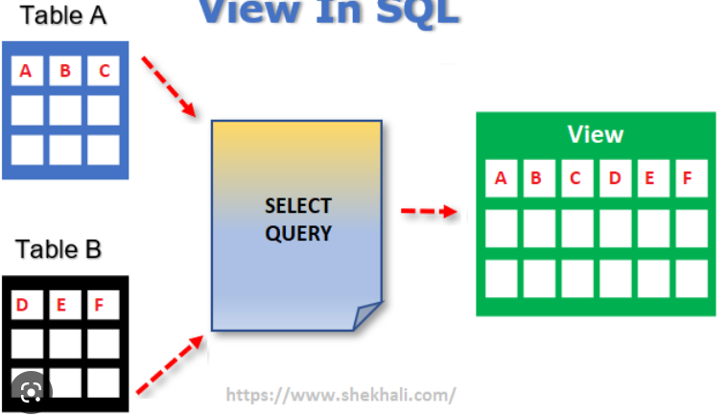
What is View and Use of Views ?
What is View
Use of Views
The primary use of view in SQL Server is to implement the security mechanism.
It prevents users from seeing specific columns and rows from tables.
A view is a database object that has no values.
It is a virtual table, which is created according to the result set of an SQL query.
View can be create based on base table or existing views
If any changes occur in the underlying table, the same changes reflected in the views also

Slide 17
Types of Views
View | Description
User-defined Views | This type of view is defined by the DB users. The compiled query is stored in the database.
Indexed Views | When you create a unique clustered index on a user-defined view, it becomes an indexed view. It improves the performance for the queries that aggregate many rows.
Partitioned Views | A partitioned view joins horizontally partitioned data from a set of member tables across one or more servers.
System Views | System views expose metadata in the database. They can be used to get information about the instance of SQL Server or the database objects, e.g. the sys.databases view to return information about the user-defined databases available in the instance

Slide 18
Syntax for view creation
Consistency
Sometimes, you need to write a complex formula or logic in every query.
To make it consistent, you can hide the complex queries logic and calculations in views.
Once views are defined, you can reference the logic from the views rather than rewriting it in separate queries.
Advantages of views
Security
You can restrict users to access directly to a table and allow them to access a subset of data via views.
For example, you can allow users to access customer name, phone, email via a view but restrict them to access the bank account and other sensitive information.
Simplicity
you can simplify the complex queries with joins and conditions using a set of views.
CREATE VIEW <schema_name>.<view_name>
AS
SELECT column1, column2, ...
FROM table1, table2,...
[WHERE];

Slide 19
Managing views in SQL Server
Modify the existing view
Rename views in SQL Server
List view information
We can use the sys.views or sys.objects catalog view to list or display all views available in a SQL Server Database.
SP_HELPTEXT view_name Syntax represent to see the view code
Drop view
ALTER VIEW view_name
AS
SELECT column1, column2, ...
FROM table1, table2,...
[WHERE];
SP_RENAME View_Old_Name,View_New_Name
Drop view schema_name. View_name

Slide 20
Check Option: The use of the Check Option in a view is to ensure that all the Update and Insert commands must satisfy the condition in the view definition.
Syntax :
Encrypt a view in SQL Server
The “WITH ENCRYPTION” option can encrypt any views. That means it will not be visible via SP_HELPTEXT.
This option encrypts the definition of the view. Users will not be able to see the definition of the view after it is created. This is the main advantage of the view where we can make it secure
Create VIEW view_name
AS
SELECT column1, column2, ...
FROM table1, table2,...
[WHERE]
With Check Option

Slide 21
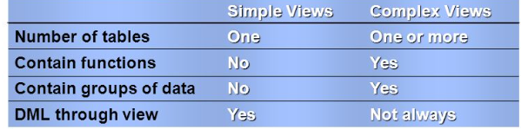
User defined views
1. Simple view
The simple view is based on the single base table without using any complex queries.
2. Complex Query
The complex view is based on more than one table along with group by clause, order by clause, and join conditions.
Simple view vs Complex view

Slide 22
SQL Server indexed view
Unlike regular views, indexed views are materialized views that stores data physically like a table hence may provide some the performance benefit if they are used appropriately.
To create an indexed view, you use the following steps:
First, create a view that uses the WITH SCHEMABINDING option which binds the view to the schema of the underlying tables.
Second, create a unique clustered index on the view. This materializes the view
CREATE VIEW schema_name.product_master
WITH SCHEMABINDING
AS
SELECT column1, column2, ...
FROM table1, table2,...
[WHERE]

Slide 23
Synonym

Slide 24
Synonym Outlines
What is Synonym and use of Synonyms?
Syntax for Synonym creation
Creation of Synonym with in the same /other db level
Listing all synonyms of a database
Removing a synonym
View vs Synonym

Slide 25
What is Synonym and use of Synonym
Synonym is the database object that provides alternate name (alias) to another database objects such as table, view, stored procedure, etc. in the local server or a remote server.
It provides a layer of abstraction and protects the client application in case of a name change or location change made to the base object.
When to use synonyms
1) Simplify object names
If you refer to an object from another database (even from a remote server), you can create a synonym in your database
and reference to this object as it is in your database.
2) Enable seamless object name changes
you can rename the table and create a synonym for it to keep existing applications function properly.
Syntax for Synonym creation
CREATE SYNONYM [ schema_name_1. ] synonym_name FOR object;

Slide 26
Examples
Creating a synonym within the same database example
Creating a synonym for a table in another database
Listing all synonyms of a database
Removing a synonym
Alter Synonym
You cannot alter a synonym. To make changes, you first have to drop the synonym and re-create it.
CREATE SYNONYM orders FOR sales.orders;
CREATE SYNONYM suppliers FOR test.purchasing.suppliers;
SELECT name, base_object_name,,type from sys.synonyms order by name;
DROP SYNONYM [ IF EXISTS ] [schema.] synonym_name

Slide 27
Sequences

Slide 28
Sequence Outlines
What is Sequence
Syntax for Sequence creation
Sequence execution with Next value and Curr value
Use SEQUENCE with a Table
Getting sequences information
Sequence vs. Identity columns
Dropping Sequence

Slide 29
The sequence is a schema-bound object that generates a sequence of numbers either in ascending or descending order in a defined interval.
It can be configured to restart when the numbers get exhausted.
A Sequence is not associated with any table.
Syntax
CREATE SEQUENCE [schema_name.] sequence_name
[ AS [ integer_type ] ]
[ START WITH start_value ]
[ INCREMENT BY increment_value ]
[ { MINVALUE [ minvalue } | { NO MINVALUE } ]
[ { MAXVALUE [ maxvalue ] } | { NO MAXVALUE } ]
[ CYCLE | { NO CYCLE } ]
[ { CACHE [ size ] } | { NO CACHE } ];

Slide 30
When to use sequences
You use a sequence object instead of an identity column in the following cases:
The application requires a number before inserting values into the table.
The application requires sharing a sequence of numbers across multiple tables or multiple columns within the same table.
The application requires to restart the number when a specified value is reached.

Slide 31
Alter sequence
Using Alter statement, we can alter the sequence
Getting sequences information
Drop the sequences
SELECT * From sys.sequences;
Drop sequence sequence_name;

Slide 32
Schema

Slide 33
Overview of Schema
schema is a logical collection of database objects such as tables, views, stored procedures, indexes, triggers, functions.
It can be thought of as a container, created by a database user. The database user who creates a schema is the schema owner.
A schema can belong to only one database whereas a database can have one or multiple schemas.
There are no restrictions on the number of objects in a schema.
SQL Server provides us with a few built-in schemas such as dbo, guest, sys, etc.
dbo is the default schema for a newly created database.
Schema ownership can be transferred from one user to another user in the same database.
A database user can be dropped without dropping the database objects owned by the user. But the schema cannot be deleted if it owns database objects.

Slide 34
Syntax for Schema creation
Note : After you create a schema, you can create objects under this schema and grant
permissions to other users.
Modify Schema
To transfer database objects from one schema to another schema in the same database
Delete a Schema
Deletes a schema from the database. The schema that is being dropped must not contain any database objects. If the schema contains objects, the DROP statement fails.
Modify Schema Owner : ALTER AUTHORIZATION ON SCHEMA :: hrdbo TO dbo
Create Schema <Schema_name> Authorization <user_name>
Alter Schma hrdbo Transfer OBJECT :: dbo.Employee;
DROP SCHEMA [IF EXISTS] schema_name

Slide 35
SubQueries

Slide 36
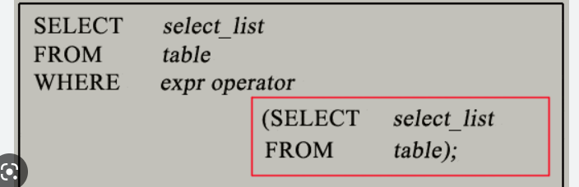
SubQueries
A subquery is a query within a query.
You can create subqueries within your SQL statements. These subqueries can reside in the select, where, From clauses and Insert, Update and Delete statements.
A subquery is also called an INNER QUERY or INNER SELECT and The main query is called Outer Query or Outer select.
The subquery will be found in the WHERE clause. These subqueries are also called nested subqueries.
A subquery can also be found in the FROM clause. These are called inline views.
Syntax :
Outer Query
Inner Query

Slide 37
Nesting subquery
A subquery can be nested within another subquery.
SQL Server supports up to 32 levels of nesting.
SQL Server subquery types
You can use a subquery in many places:
1. In place of an expression
2. With IN or NOT IN
3. With ANY or ALL
4. With EXISTS or NOT EXISTS
5. In UPDATE, DELETE, or INSERT statement
6. In the FROM and Where clause

Slide 38
correlated subquery
A correlated subquery is a subquery that uses the values of the outer query.
Correlated subqueries are used for row-by-row processing.
Each subquery is executed once for every row of the outer query.
Few Rules for Subqueries:
An Order by cannot be used in Subquery
Subquery must be enclosed with in parenthesis
A subquery that uses an Exists operator always is a correlated subquery

Slide 39
CTE (Common Table Expression)

Slide 40
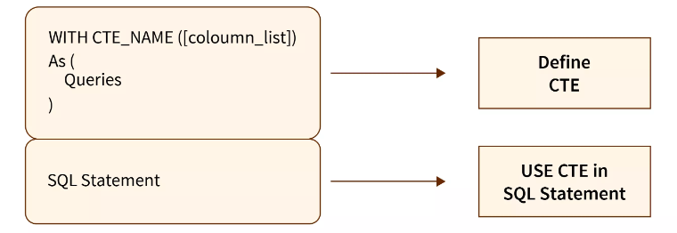
Common Table Expressions (CTEs) allow us to create temporary named results sets that exist temporarily within the execution scope of SQL statements such as SELECT, INSERT, UPDATE, DELETE, and MERGE.
Syntax of CTE In SQL Server
Before the CTEs, we were using the derived table to define a large and complex query.
The table is being called temporary because it exists only during the scope of the SQL statement written after CTEs.
WITH <common_table_expression> ([column names])
AS
(
<cte_query_definition>
)
<sql_statement>
Notes:
https://www.scaler.com/topics/cte-in-sql-server/

Slide 41
Why Do We Need CTE In SQL Server?
Using sub-queries in SQL, we can join the records or filter the records from a sub-query. We face maintainability issues whenever we refer to the same data or use the same sub-query to join the same records.
Additionally, there are Derived Tables, Temporary Tables, and Temporary Variables approaches in SQL that are somewhat similar to CTE, although each has its own set of cons compared to CTE.
Common Table Expression proves its worth with improved readability and easier maintenance.

Slide 42
Advantages
Some of its advantages are given below:
CTE facilitates code maintenance easier.
CTE increases the readability of the code.
It increases the performance of the query.
CTE makes it possible to implement recursive queries easily.
Multiple CTE
The multiple CTE definition can be defined using UNION, UNION ALL, JOIN, INTERSECT, or EXCEPT.
WITH
cte_name1 (column_names) AS (query),
cte_name2 (column_names) AS (query)
as
select Query

Slide 43
SQL TEMP TABLE

Slide 44
Temporary tables are tables that exist temporarily on the SQL Server.
The temporary tables are useful for storing the immediate result sets that are accessed multiple times.
Types of Temporary Tables:
1. Local Temporary Table
2. Global Temporary Table
Creating temporary tables:
Two ways to create temporary tables
1. Select Into
2. Create Table

Slide 45
Local Temp Table
Local temp tables are only available at current connection time.
It is automatically deleted when user disconnects from instances.
It is started with hash (#) sign.
Syntax : create table #test (------------------);
Global Temp Table
Global temp tables name starts with double hash (##).
Once this table is created, it is like a permanent table.
It is always ready for all users and not deleted until the total connection is withdrawn.
Syntax : create table ##Acnt_dets(---------------);

Slide 46
Create temporary tables using SELECT INTO statement
Dropping temporary tables
Automatic removal
1. SQL Server drops a temporary table automatically when you close the connection that created it.
2. SQL Server drops a global temporary table once the connection that created it closed and the queries
against this table from other connections completes.
Manual Deletion
Select <select list> into temp_table
From table_name
Drop table ##temp_table

Slide 47
Dynamic SQL

Slide 48
Dynamic SQL is a programming technique where you build SQL query as a string and execute it dynamically at runtime.
The dynamic SQL query string can be executed using EXEC or EXECUTE command or using the sp_executesql stored procedure.
You can also build and execute SQL query string by directly passing the SQL query string to sp_executesql stored procedure, as shown below.
Example :
exec sp_executesql N'SELECT * FROM EMPLOYEE WHERE EMPID = @empId’,
N'@empid nvarchar(50)', @empId = '5’
Dynamic SQL for DML and DDL Statements
Dynamic SQL in the Stored Procedure
sp_executesql N'SQL query', N'@param1 data_type', @param1 = 'value1'

Slide 49
Advantages and Disadvantages of Dynamic SQL
Advantages
Dynamic SQL is flexible and can be reused by using parameters in building the query.
Performance is improved as a better execution plan is generated.
Disadvantages
Hard to debug.
Error management is difficult and unreliable.
Dynamic SQL is slower than static SQL as SQL Server must generate an execution plan every time at runtime.
Dynamic SQL requires the users to have direct access permission on all accessed database objects like tables and views.
Notes:
https://www.tutorialsteacher.com/sqlserver/dynamic-sql

Slide 50
Miscellaneous

Slide 51
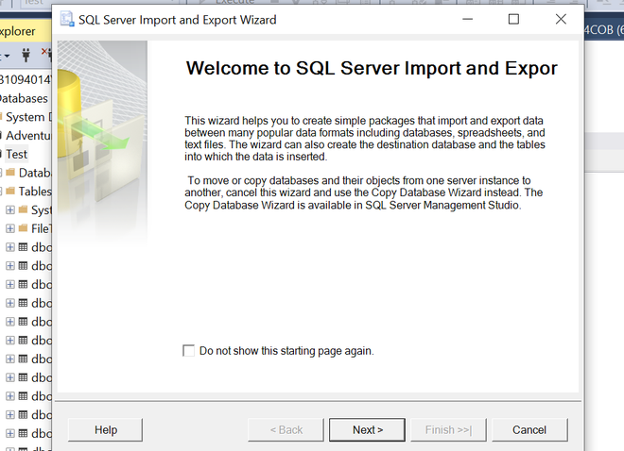
Bulk Insert
Sometimes there is a scenario when we have to perform bulk insert data from .csv files into SQL Server database.
We can use the GUI interface in SSMS(SQL Server Management Studio) to import data from Excel, CSV, etc files.
What if we have millions of data to be imported, the above will be a time-consuming task so, now you will see how you can handle such kinds of operation.
GUI interface (SSMS)

Slide 52
Bulk insert (Another Approach)
Using T-SQL Command
Example :
BULK INSERT table_name
FROM path_to_file
WITH options;
BULK INSERT Employees
FROM 'D:\data\employees.csv'
WITH (
FIELDTERMINATOR = ',',
ROWTERMINATOR = '\n',
FIRSTROW = 2
);
Notes:
https://www.sqlservertutorial.net/sql-server-administration/sql-server-bulk-insert/

Slide 53
CASE Statement
The CASE is a statement that operates if-then-else type of logical queries.
CASE statement is used in SELECT, INSERT, and DELETE statements with the following three clauses
WHERE Clause
ORDER BY Clause
GROUP BY Clause
Types of CASE Statements
1. Simple CASE
2. Searched CASE
Case expression in Where
Case expression in Group by
Case expression in Order by
Case expression in CTE
Notes:
https://www.javatpoint.com/sql-case
SELECT ProductName, CASE CategoryID
WHEN 1 THEN 'Electronics’
WHEN 2 THEN 'Clothing’
ELSE 'Other’
END AS Category
FROM Products;
Example 2:
SELECT ProductName,
CASE
WHEN Price > 1000 THEN 'Expensive’
WHEN Price > 500 THEN 'Moderate’
ELSE 'Affordable’
END AS PriceCategory
FROM Products;

Slide 54
Syntax for Simple CASE:
Syntax for searched CASE:
CASE <expression>
WHEN condition_1 THEN statement_1
WHEN condition_2 THEN stateent_2 …….
WHEN condition_N THEN statement_N
ELSE result
END;
CASE
WHEN <Boolean_Expression_1> THEN Statement_1
WHEN <Boolean_Expression_2> THEN Statement_2
.
.
WHEN <Boolean_Expression_N> THEN Statement_N
[ELSE Statement_Else]
END AS [ALIAS_NAME]
Notes:
https://www.guru99.com/sql-server-case.html

Slide 55
DISTINCT clause
to retrieve the only distinct values in a specified list of columns.
Offset and Fetch
Offset : The number of rows to skip before starting to return rows from the query.
Fetch : the number of rows to return after the OFFSET clause has been processed
The OFFSET clause is mandatory while the FETCH clause is optional.
You must use the OFFSET and FETCH clauses with the ORDER BY clause. Otherwise, you will get an error.
SELECT DISTINCT
column_name1,
column_name2 ,
...
FROM
table_name;

Slide 56
Example:
Syntax for Fetch and OFFSET
Example:
ORDER BY column_list [ASC |DESC]
OFFSET offset_row_count {ROW | ROWS}
FETCH {FIRST | NEXT} fetch_row_count {ROW | ROWS} ONLY
SELECT product_name, list_price
FROM production.products
ORDER BY
list_price,
product_name
OFFSET 10 ROWS
FETCH NEXT 10 ROWS ONLY;

Slide 57
Select TOP Clause
The SELECT TOP clause allows you to limit the number of rows or percentage of rows returned in a query result set.
TOP keyword is an expression that specifies the number of rows to be returned. The expression
The PERCENT keyword Indicates that the query returns the first N percentage of rows
The WITH TIES allows you to return more rows with values that match the last row in the limited result set
1. SELECT TOP 10 Product_name,Qty from Products
2. SELECT TOP 1 PERCENT product_name, Qty
from products
3. SELECT TOP 3 WITH TIES product_name, Qty
from products
SELECT TOP (expression) [PERCENT] [WITH TIES] FROM table_name ORDER BY column_name;

Slide 58
IDENTITY column
To add an identity column to a table.
The seed is the value of the first row loaded into the table.
The increment is the incremental value added to the identity value of the previous row.
Example:
IDENTITY[(seed, increment)]
CREATE TABLE hr.person (
person_id INT IDENTITY(1,1) PRIMARY KEY,
first_name VARCHAR(50) NOT NULL,
last_name VARCHAR(50) NOT NULL,
gender CHAR(1) NOT NULL
);

Slide 59
SELECT INTO statement
SELECT INTO statement creates a new table and inserts rows from the query into it.
SELECT INTO statement creates the destination table and copies rows, which satisfy the WHERE condition, from the source table to the destination table.
Syntax:
SELECT
select_list
INTO
destination
FROM
source
[WHERE condition]
Example
SELECT
*
INTO
marketing.customers
FROM
sales.customers;

Slide 60
INSERT INTO SELECT statement
To insert data from other tables into a table
Examples
INSERT [ TOP ( expression ) [ PERCENT ] ]
INTO target_table (column_list)
query
INSERT INTO sales.addresses (street, city, state, zip_code)
SELECT
street,
city,
state,
zip_code
FROM
sales.customers
INSERT TOP (10) INTO sales.addresses (street, city, state, zip_code)
SELECT
street,city,state,zip_code
FROM
sales.customers

Slide 61
CREATE And Drop DATABASE
The CREATE DATABASE statement creates a new database
lists all databases in the SQL Server
Or you can execute the stored procedure sp_databases:
CREATE DATABASE database name;
SELECT name from master.sys.databases order by name
EXEC sp_databases;
DROP DATABASE statement allows you to delete one or more databases
DROP DATABASE [ IF EXISTS ]
database_name
[,database_name2,...];
you cannot drop the database that is currently being used

Slide 62
SQL Server XML Data Type
The XML data type is a very common data type that is used to store unstructured or heterogeneous data in SQL Server.
We can use xml data type like as:
Variable
Field/Column in a table
Parameter in the user-defined function (UDF) or stored procedure(SP)
return value from a UDF or SP
SELECT DeptName, EmpID
FROM Employee AS Emp JOIN Department AS Dept
ON Emp.DeptID= Dept.DeptID
FOR XML AUTO;

Slide 63
Q
A
Thank you

